Slide 1
Chapter 5: Logical Database Design and the Relational Model
Modern Database Management
6th Edition
Jeffrey A. Hoffer, Mary B. Prescott, Fred R. McFadden

Slide 2
Relation
Definition: A relation is a named, two-dimensional table of data
Table is made up of rows (records), and columns (attribute or field)
Not all tables qualify as relations
Requirements:
Every relation has a unique name.
Every attribute value is atomic (not multivalued, not composite)
Every row is unique (can’t have two rows with exactly the same values for all their fields)
Attributes (columns) in tables have unique names
The order of the columns is irrelevant
The order of the rows is irrelevant
NOTE: all relations are in 1st Normal form

Slide 3
Correspondence with ER Model
Relations (tables) correspond with entity types and with many-to-many relationship types
Rows correspond with entity instances and with many-to-many relationship instances
Columns correspond with attributes
NOTE: The word relation (in relational database) is NOT the same same the word relationship (in ER model)

Slide 4
Key Fields
Keys are special fields that serve two main purposes:
Primary keys are unique identifiers of the relation in question. Examples include employee numbers, social security numbers, etc. This is how we can guarantee that all rows are unique
Foreign keys are identifiers that enable a dependent relation (on the many side of a relationship) to refer to its parent relation (on the one side of the relationship)
Keys can be simple (a single field) or composite (more than one field)
Keys usually are used as indexes to speed up the response to user queries.

Slide 5
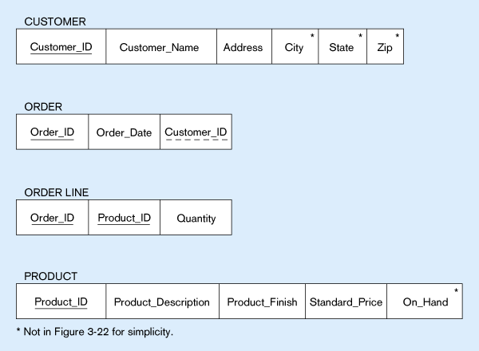
Figure 5-3 -- Schema for four relations (Pine Valley Furniture)
Primary Key
Foreign Key (implements 1:N relationship between customer and order)
Combined, these are a composite primary key (uniquely identifies the order line)…individually they are foreign keys (implement M:N relationship between order and product)

Slide 6
Integrity Constraints
Domain Constraints
Allowable values for an attribute.
Entity Integrity
No primary key attribute may be null. All primary key fields MUST have data
Action Assertions
Business rules.

Slide 7
Integrity Constraints
Referential Integrity – rule that states that any foreign key value (on the relation of the many side) MUST match a primary key value in the relation of the one side. (Or the foreign key can be null)
For example: Delete Rules
Restrict – don’t allow delete of “parent” side if related rows exist in “dependent” side
Cascade – automatically delete “dependent” side rows that correspond with the “parent” side row to be deleted
Set-to-Null – set the foreign key in the dependent side to null if deleting from the parent side → not allowed for weak entities

Slide 8
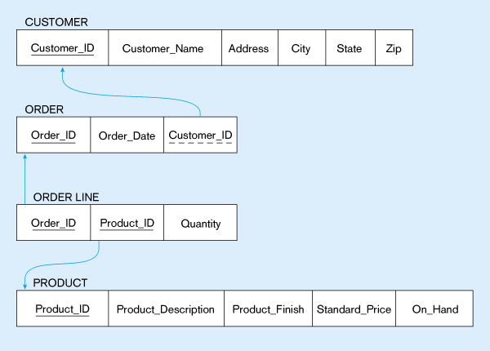
Figure 5-5:
Referential integrity constraints (Pine Valley Furniture)
Referential integrity constraints are drawn via arrows from dependent to parent table

Slide 9
Transforming EER Diagrams into Relations
Mapping Regular Entities to Relations
Simple attributes: E-R attributes map directly onto the relation
Composite attributes: Use only their simple, component attributes
Multi-valued Attribute - Becomes a separate relation with a foreign key taken from the superior entity

Slide 10
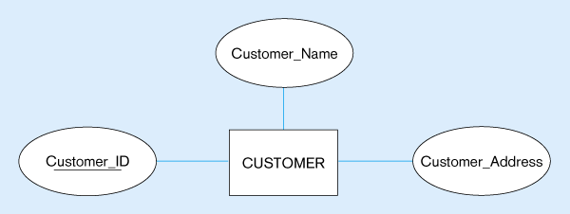
Figure 5-8: Mapping a regular entity
(a) CUSTOMER entity type with simple attributes
(b) CUSTOMER relation

Slide 11
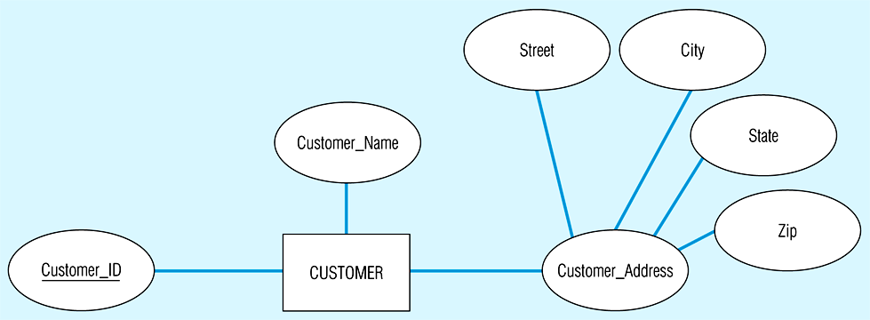
Figure 5-9: Mapping a composite attribute
(a) CUSTOMER entity type with composite attribute
(b) CUSTOMER relation with address detail

Slide 12
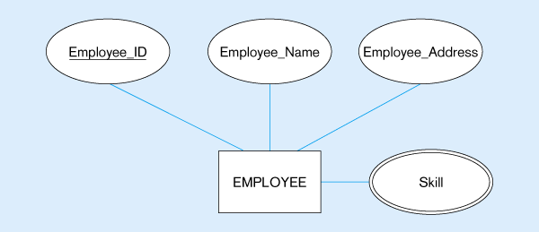
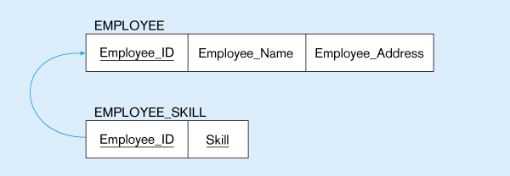
Figure 5-10: Mapping a multivalued attribute
(a)
Multivalued attribute becomes a separate relation with foreign key
(b)
1 – to – many relationship between original entity and new relation

Slide 13
Transforming EER Diagrams into Relations
Mapping Weak Entities
Becomes a separate relation with a foreign key taken from the superior entity
Primary key composed of:
Partial identifier of weak entity
Primary key of identifying relation (strong entity)

Slide 14
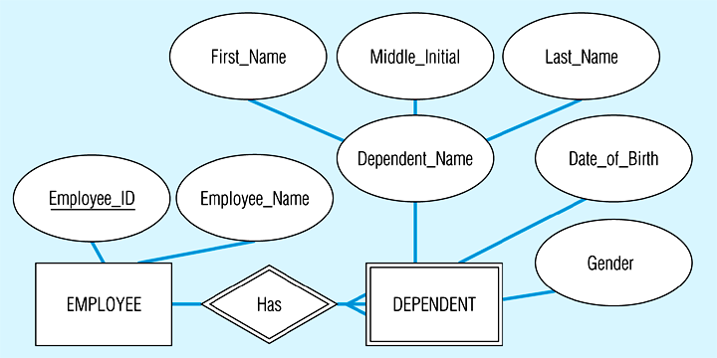
Figure 5-11: Example of mapping a weak entity
(a) Weak entity DEPENDENT

Slide 15
Figure 5-11(b) Relations resulting from weak entity
NOTE: the domain constraint for the foreign key should NOT allow null value if DEPENDENT is a weak entity
Foreign key
Composite primary key

Slide 16
Transforming EER Diagrams into Relations
Mapping Binary Relationships
One-to-Many - Primary key on the one side becomes a foreign key on the many side
Many-to-Many - Create a new relation with the primary keys of the two entities as its primary key
One-to-One - Primary key on the mandatory side becomes a foreign key on the optional side

Slide 17
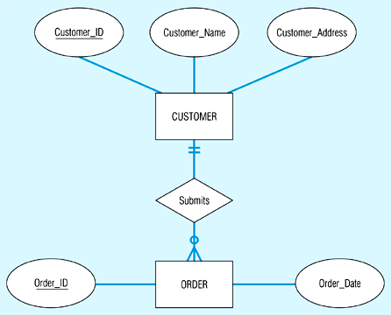
Figure 5-12: Example of mapping a 1:M relationship
(a) Relationship between customers and orders
Note the mandatory one

Slide 18
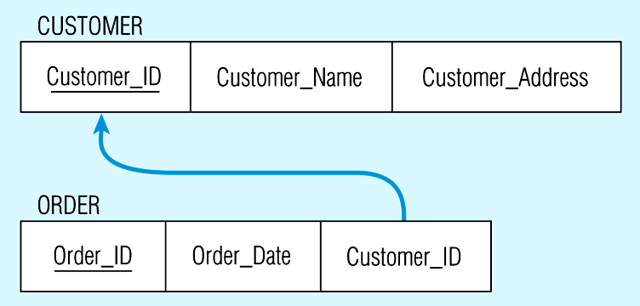
Figure 5-12(b) Mapping the relationship
Again, no null value in the foreign key…this is because of the mandatory minimum cardinality
Foreign key

Slide 19
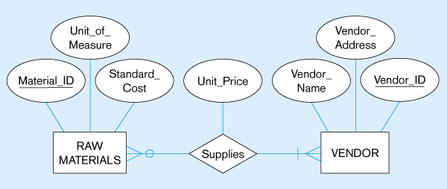
Figure 5-13: Example of mapping an M:N relationship
(a) ER diagram (M:N)
The Supplies relationship will need to become a separate relation

Slide 20
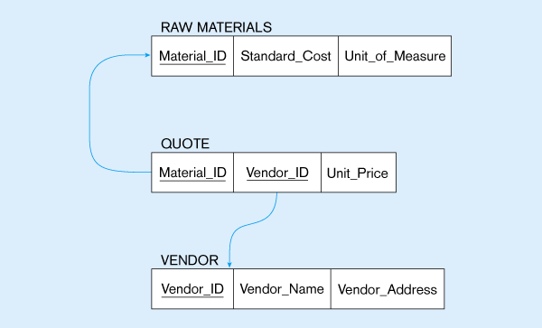
Figure 5-13(b) Three resulting relations
Composite primary key
New intersection relation
Foreign key
Foreign key

Slide 21
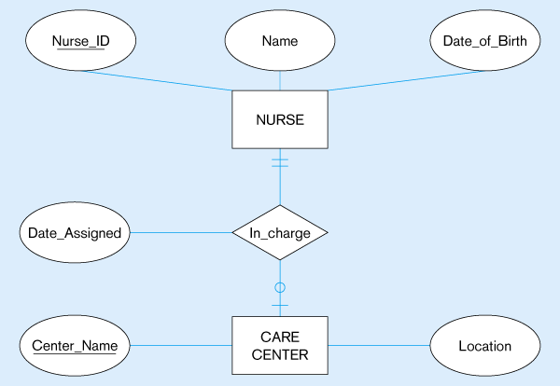
Figure 5-14: Mapping a binary 1:1 relationship
(a) Binary 1:1 relationship

Slide 22
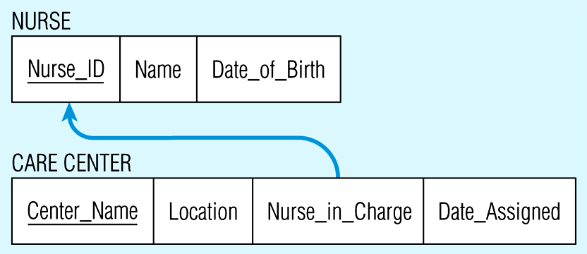
Figure 5-14(b) Resulting relations

Slide 23
Transforming EER Diagrams into Relations
Mapping Associative Entities
Identifier Not Assigned
Default primary key for the association relation is composed of the primary keys of the two entities (as in M:N relationship)
Identifier Assigned
It is natural and familiar to end-users
Default identifier may not be unique

Slide 24
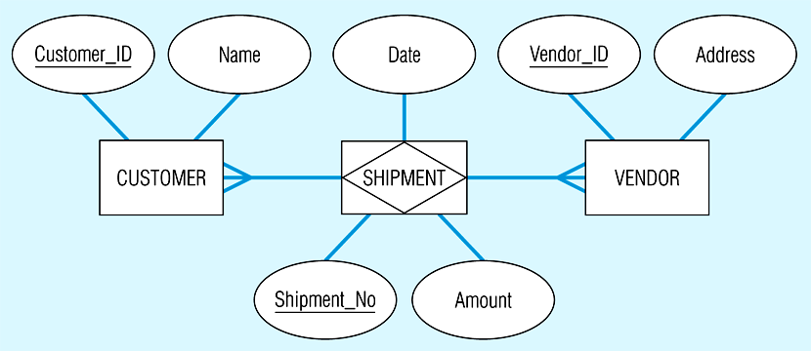
Figure 5-15: Mapping an associative entity
(a) Associative entity

Slide 25
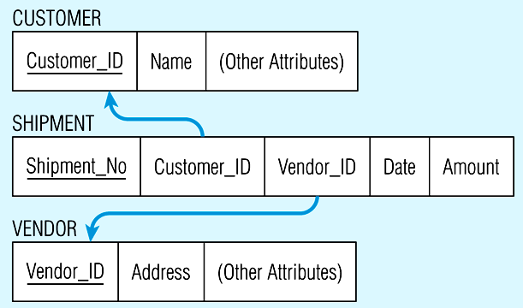
Figure 5-15(b) Three resulting relations

Slide 26
Transforming EER Diagrams into Relations
Mapping Unary Relationships
One-to-Many - Recursive foreign key in the same relation
Many-to-Many - Two relations:
One for the entity type
One for an associative relation in which the primary key has two attributes, both taken from the primary key of the entity

Slide 27
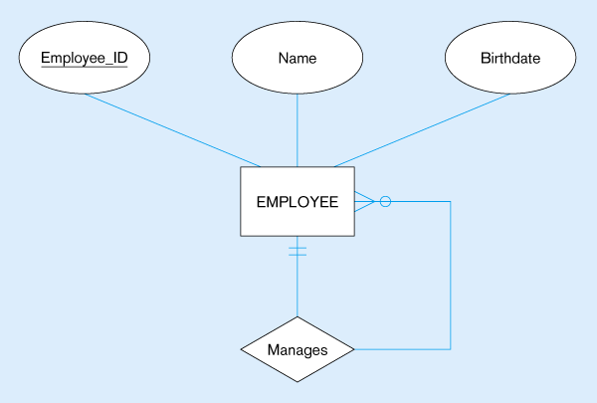
Figure 5-17: Mapping a unary 1:N relationship
(a) EMPLOYEE entity with Manages relationship
(b) EMPLOYEE relation with recursive foreign key

Slide 28
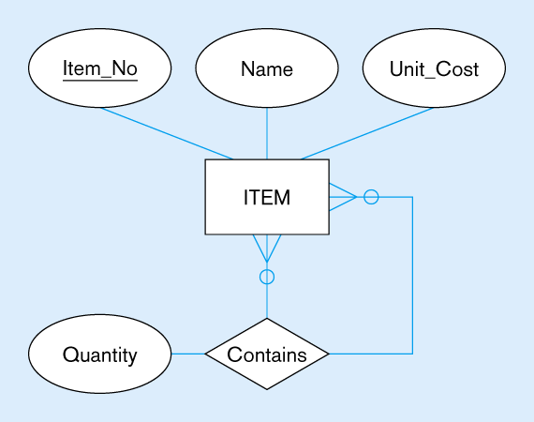
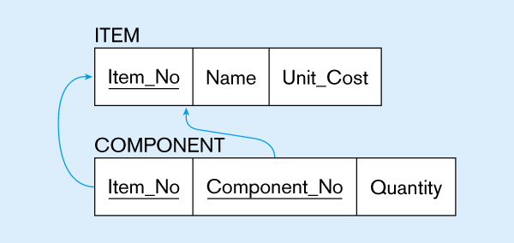
Figure 5-18: Mapping a unary M:N relationship
(a) Bill-of-materials relationships (M:N)
(b) ITEM and COMPONENT relations

Slide 29
Transforming EER Diagrams into Relations
Mapping Ternary (and n-ary) Relationships
One relation for each entity and one for the associative entity
Associative entity has foreign keys to each entity in the relationship

Slide 30
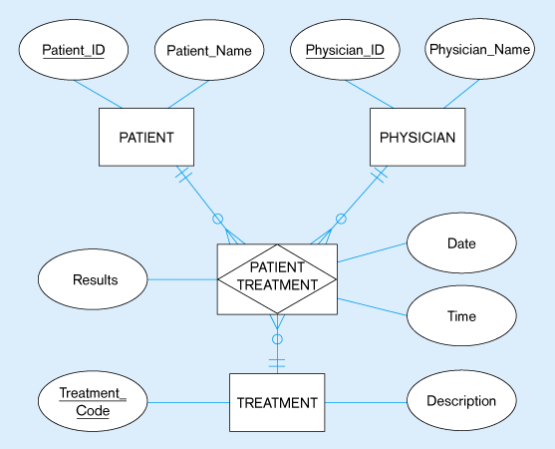
Figure 5-19: Mapping a ternary relationship
(a) Ternary relationship with associative entity

Slide 31
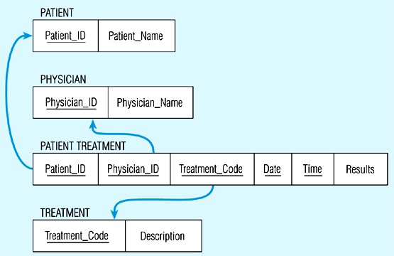
Figure 5-19(b) Mapping the ternary relationship
Remember that the primary key MUST be unique

